Slide 1
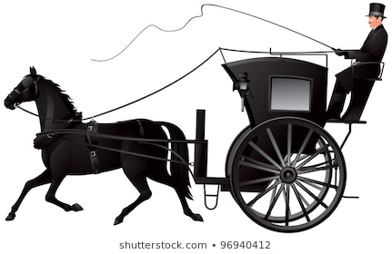
HOME LEARNING PROJECT
Postcards of Hinckley’s Past #2
Hinckley Past & Present Website: http://www.hinckleypastpresent.org/hinckley.html Hinckley has a long and rich history. This week’s theme is to discover more about the town we live in and create a set of postcards to capture important historical moments. On one side of the postcard draw a picture; and capture the history on the reverse of the card.
Postcard 7: 1730 - Dick Turpin Dick Turpin visited the area in 1730. Discover who Dick Turpin was, the name of his horse and his profession! Record a picture to represent him on your post card. His famous words were captured in a pop song in the 1980s. Can you discover the artist and song? The website below will help. Take it further: Write an autobiography on Dick Turpin. https://www.bbc.co.uk/bitesize/guides/z2cqrwx/revision/4 | Postcard 8: 1804 - The Ashby Canal Discover what a canal boat looks like and draw a picture. Younger children might like to watch Rosie and Jim TV which was filmed on canals around Birmingham. Find out what two products were carried along the canal through Hinckley. Can you think of a local pub that bears the name of one of these products? Rosie & Jim https://www.youtube.com/watch?v=P0rVHKuEP68 Take it further: Research canal boat art and get creative! Perhaps decorate a paper plate, plant pot or simply use card or paper.
Postcard 9: 1835 AD - The Hansom Cab Discover the inventor of the Hansom Cab whose design transported the Victorian traveller. Capture a picture and record some facts about this interesting inventor on the back. | Postcard 10: 1889 AD – Hinckley Town Football Club Hinckley has had a football club for over 100 years. But in this time, the club has had 4 different names. Draw a picture to represent today’s football team and discover the 3 other titles.
Postcard 11: 1939 – 1945 AD World War II In 1941, The Hinckley and District Hosiery Association donated money to pay for 2 Spitfires; The Hinckley Spitfire and Burbage Spitfire. Draw a picture of a spitfire on your postcard. Take it further: The Hinckley Spitfire had a long life and started its career in a squadron commanded by Douglas Bader. Find out who this British hero was and create a factoid in the shape of a spitfire. https://primaryfacts.com/4806/douglas-bader-facts-and-information/ | Postcard 12: Present Day History You are an important part of Hinckley’s history. Create a postcard about you and your family connections to the town.

